Slide 1
Crimewatch UK (transcript)
We have just received worrying news about a series of burglaries along Numbers Street in Birmingham over the last 5 nights.
The following houses were broken into and expensive items taken.
On the first night a married couple living at 5 Numbers Street, had their TV stolen.
On the second night, a man was robbed of his rare stamps collection. He was living at 9 number street.
On the third night, the burglar struck a woman at 13 Numbers Street and took her designer shoes.
The fourth night an old grandmother, living at 17 Numbers street lost her gold false teeth to the thief.
The most recent report from Birmingham police shows the burglar has just broken into 21 Numbers Street. A man who is yet to be named is reported to have lost his pet lizard to the criminal.
Notes:
Make a video of yourself as a news reporter. The kids love it.
Personalise it for your school.

Slide 2
Detective Chief ____ of Birmingham Police has told this us: ‘We have noticed that there is a pattern to the thief’s attacks. Our detectives have put together this diagram to show the burglar’s movements. If you have any idea where the thief will strike next, please write in to let us know. You will need to explain how you know so we can be certain it will happen.’
Notes:
Get another teacher to be the detective.

Slide 3

Police diagram
1st
2nd
3rd
4th
5th
5 | 6 | 7 | 8 | 9 | 10 | 11 | 12 | 13 | 14 | 15 | 16 | 17 | 18 | 19 | 20 | 21

Slide 4

Dear Police,
I believe that on the 6th night the thief will try to steal from house number ________ Numbers Street.
I know this because...
I hope you catch the thief!
<Your name>

Slide 5

Police statement
Due to the information from key local helpers, we were able to work out that the burglar targets a house 4 doors down from the previous night.
Mr and Mrs. Rashid of 25 Numbers Street were warned in time and made sure the burglar didn’t get in.
We are now planning a capturing attempt on the 10th night,
we need information on which house to wait at.

Slide 6
Night | House
1 | 5
2 | 9
3 | 13
4 | 17
5 | 21
6
7
8
9
10

Slide 7

Dear Police,
On the 10th night you should wait for
the burglar at _______ Numbers Street.
I hope you catch the thief!
<Your name>

Slide 8
Police update
We are very pleased to have caught the Numbers Street burglar, however his actions have led to copycat burglaries across the city.
We need as much local help as we can get to solve these new crimes!

Slide 9
Night | House
1 | 5
2 | 9
3 | 13
4 | 17
5 | 21
6 | 25
7 | 29
8 | 33
9 | 37
10 | 41
Position
Term
To find the pattern of a sequence (term to term rule), subtract a term from the one before.

Slide 10
Police update
We are very pleased to have caught the Numbers Street burglar, however his actions have led to copycat burglaries across the city.
We need as much local help as we can get to solve these new crimes!

Slide 11
Police instructions
For each crime, we need to know
Which houses will be targeted over the next three nights so we can warn the residents.
What the pattern of attack is (term to term rule).
1.
2.
3.
Night | 1 | 2 | 3 | 4 | 5 | 6 | 7
House no. | 86 | 89 | 92 | 95
Night | 1 | 2 | 3 | 4 | 5 | 6 | 7
House no. | 35 | 32 | 29 | 26
Night | 1 | 2 | 3 | 4 | 5 | 6 | 7
House no. | 2 | 4 | 8 | 16

Slide 12
Sequences
Not all sequences only use positive integers.
What do you think of this..
10, 7, 4, 1... Now what?
2.4, 2.6, 2.8... Now what?

Slide 13
Sequences
Not all sequences have the same term-to-term difference so you have to write the differences down.
What’s going on in these..?
5, 7, 10, 14, 19...
2, 3, 5, 9, 17...
1, 1, 2, 3, 5, 8...

Slide 14
Generating sequences
Given this rule, what does the sequence look like?
Start with 8
Fill in the next 5 terms by adding 6 to the previous term
Start with 10
Fill in the next 5 terms by halving the previous term

Slide 15
Burglar vs Police
First, pretend to be a burglar.
Burglars need to come up with a sequence of houses they want to steal from.
Swap your sequence with someone else
Next pretend to be police.
Police have to work out the pattern and the term to term rule.

Slide 16
Be a SUPER detective
The BIG question:
What if I asked you to predict the house number (term) on the 30th night, 100th night or 500th night?
Rather than just continuing the pattern,
What’s the fastest way to tell where the burglar will be on any night (n)?
Hint: Is there a link between the position of the term, and the term itself? (the night, and the house number)
Hint: Try and multiply the term-to-term rule by the position, how far is it out?

Slide 17
Position to term (General rule)
Position (Night) | Term (House) | Term to term | Position x Term to term | How to get to the term
1 | 5 | + 4 | 1 x 4 = 4 | + 1
2 | 9 | + 4 | 2 x 4 = 8 | + 1
3 | 13 | + 4 | 3 x 4 = 12 | + 1
4 | 17 | + 4 | 4 x 4 = 16 | + 1
5 | 21 | + 4 | 5 x 4 = 20 | + 1
Any night (n) = Term to term x n + the amount to get back to the term.
Nth term = 4n + 1
Try it! On the 10th night...
4 x 10 + 1 = 40 + 1 = 41!
On the 500th Night?

Slide 18
General rule (Nth term) - The shortcut: find the burglar’s base!
BASE 0
1st
2nd
3rd
4th
1 | 2 | 3 | 4 | 5 | 6 | 7 | 8 | 9 | 10 | 11 | 12 | 13 | 14 | 15 | 16 | 17
term to term
(first term – term to term)
nth term = n +

Slide 19
Let’s try it with another sequence
Position | 1 | 2 | 3 | 4 | 5 | 6
Term
Get pupils to produce their own video as if they are news reporters and get them to present their own problem
http://nrich.maths.org/2290
Notes:
A ‘burglar’ example

Slide 20
Bad maths joke time!
Why is six afraid of seven?
Because seven ate nine.

Slide 21
Your turn to be the super detective
For each sequence
Copy it down in your books
Write down the term to term difference
Work out the general rule!
Check it for the 6th term
Super!
19, 21, 23, 25, 27
20, 40, 60, 80, 100
2, 5, 8, 11, 14
21, 18, 15, 12, 9

Slide 22
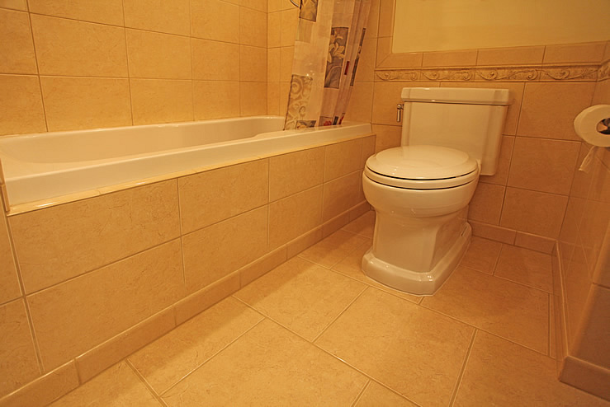
Bathroom tiles – practical maths!

Slide 23
Bathroom tiles – practical maths!
Number of green tiles | 1 | 2 | 3 | 4 | 5
Number of blue tiles | 8 | 13 | 18
Term to term rule is + 5 each time so
nth term = 5n + (8 – 5) = 5n + 3.

Slide 24
Plenary: Nth term crossword

